Slide 1
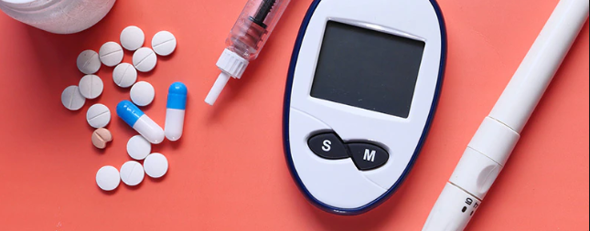
Case Study - Diabetes Data Analysis
Submitted by:
Akash Mathur

Slide 2
Executive Summary
Business Problem - Task is to conduct an exploratory data analysis (EDA) on a diabetes dataset and build a predictive model to determine whether a person is diabetic or not.
Objective: The objective is to design and implement a predictive model that utilizes machine learning algorithms to analyze relevant data and predict the likelihood of an individual having diabetes. By leveraging historical medical records, demographic information, and other pertinent variables, the model will provide a binary classification output, indicating whether a person is diabetic or not.
Methodology:
Data Collection: Provided (dataset_diabetes) is originally from National Inst of Diabetes and Digestive and Kidney Diseases. All the patients are females, 21 years or older of Pima Indian Heritage.
Data Preprocessing: Cleaned the original data, handle missing values, perform feature engineering and split the dataset into training, and testing subsets.
Feature Selection: Utilized feature selection methods such as correlation analysis and feature importance graph to identify the most informative and relevant features for the predictive model.
Model Selection: Evaluated various machine learning algorithms such as Logistic Regression, Decision Tree and Random Forest and applied multiple sampling techniques like SMOTE, ADASYN, SMOTE-Tomek and SMOTEENN to handle imbalanced data.
Model Training and Evaluation: Trained all 3 models on the training dataset and optimize hyperparameters using cross-validation and randomized search. Evaluate the model's performance on the validation dataset using F1-Score and AUC-ROC which are robust metrics for evaluating imbalanced data.

Slide 3
Data Overview

Slide 4
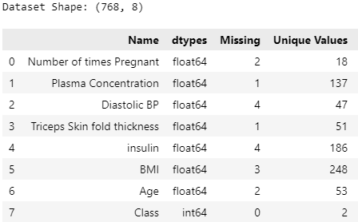
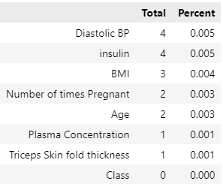
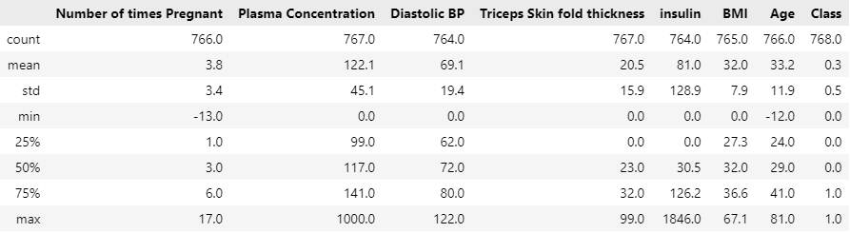
Data Overview
Original Dataset
Missing Values Analysis
Descriptive Statistics
Descriptive Statistics Insights
Independent variables - 'Number of times Pregnant', 'Plasma Concentration', 'Diastolic BP’, 'Triceps Skin fold thickness', 'insulin', 'BMI', 'Age’ | Dependent variable – Class
Number of times Pregnant: The mean value is around 3.8, indicating that on average, women in this dataset have been pregnant about 4 times. However, we see a minimum value of -13, which is not realistic and indicates an error in the dataset.
Plasma Concentration: The average glucose concentration is around 122. However, the minimum value is 0, which indicates that the substance being measured is not present or is below the detection limit in the plasma.
Diastolic BP: The average diastolic blood pressure is around 69. The minimum value is 0, which is not possible and indicates incorrect data.
Triceps Skin fold thickness: The mean thickness is around 20.5. The minimum value is 0, which indicate that there is no subcutaneous fat present in the triceps area, or it is below the detection limit of the assessment being used.
Insulin: The average insulin level is around 81. However, the minimum value is 0, which indicates that there is no detectable insulin present in the sample or that the insulin concentration is below the detection limit.
BMI: The average BMI is around 32. The minimum value is 0, which is not realistic and indicates incorrect data.
Age: The average age is around 33 years. The minimum value is -12, which is not possible and indicates incorrect data.
Class: The mean is around 0.35, indicating that about 35% of the women in this dataset have diabetes, and 65% non-diabetic. This is an Imbalance Dataset, hence the ML approach taken SHOULD be fully compatible with imbalanced dataset.
Missing Value Analysis
Missing values are negligible in the dataset.

Slide 5
Unexpected Insights & Data Quality

Slide 6
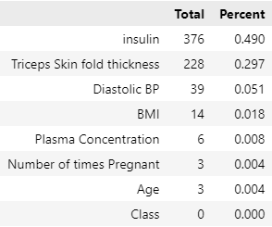
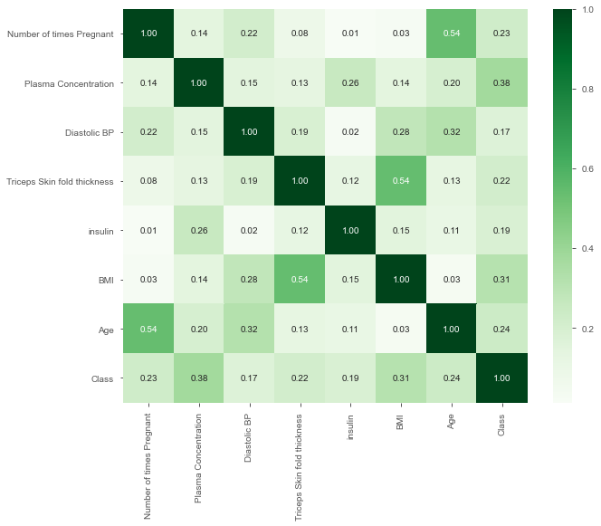
Unexpected Insights & Data Quality
Improved Missing Values Analysis
Unexpected Insight
It was observed that a significant number of women had a Triceps Skin fold thickness, Diastolic BP, BMI, Plasma Concentration value equal to 0, which was initially treated as a missing value. This unexpected observation suggests that there may have been a systematic issue with data collection or recording. Further investigation into the data collection process and potential sources of bias would be necessary to understand the underlying reasons for this observation.
Addressing these unexpected observations is crucial to ensure the accuracy and reliability of the subsequent data analysis and modeling processes.
Improving the Data Quality
All the NEGATIVE and ZERO values across independent variables are converted to NaN (except 'Number of times Pregnant’ which can be ZERO)
The number of missing values has increased, especially for 'Triceps Skin fold thickness' and 'Insulin', indicating that zero values might have been used to fill in for missing values.
Missing Values Imputation Strategy
Due to lack of business knowledge, I opted a median strategy to fill the missing values of each column.
Feature Relationships - Correlation Analysis
Number of times Pregnant and Age have a strong positive correlation of 0.54, which makes sense because older women have had more time to have pregnancies.
Triceps Skin fold thickness and BMI have a strong positive correlation of 0.54, which implies a significant correlation.
Class has notable positive correlations with Plasma Concentration (0.38), BMI (0.31), and Age (0.25), Number of times Pregnant (0.23) . This indicates that these factors might be good predictors for diabetes.
Correlation Heatmap

Slide 7
Key Findings
Univariate Analysis
Outliers Analysis
Bi-variate Analysis
Feature Engineering
Model Development - Comparison Analysis

Slide 8
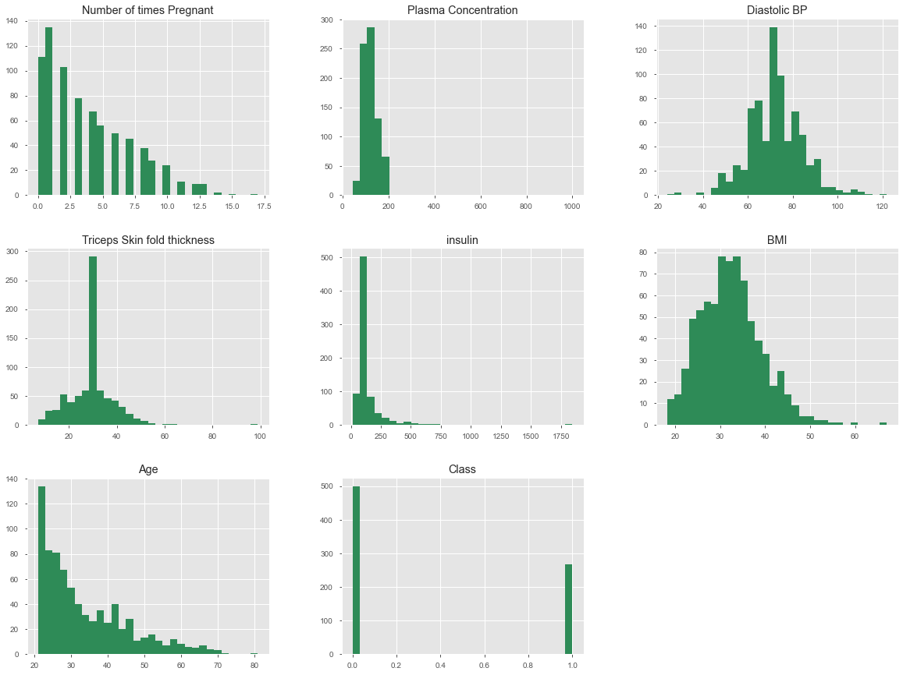
Univariate Analysis
From the histogram plots, we can observe the following:
Number of times Pregnant: Most women have been pregnant less than 5 times, with a significant number never having been pregnant.
Plasma Concentration: The distribution looks roughly Gaussian (normal), but with a spike at around 120.
Diastolic BP: The distribution is fairly normal, but with a noticeable spike around 70.
Triceps Skin fold thickness: Many women have a thickness of around 30.
Insulin: The majority of women have insulin levels around 30-40, but there's a long tail, indicating a few women with very high levels.
BMI: The distribution is roughly normal, with a peak around 30-35.
Age: Most women are less than 40 years old, with very few older women.
Class: The dataset is imbalanced, with more women without diabetes (0) than with diabetes (1).

Slide 9
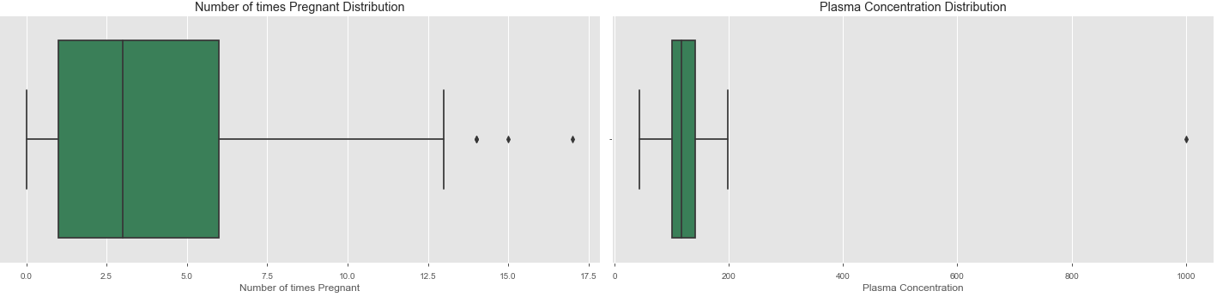
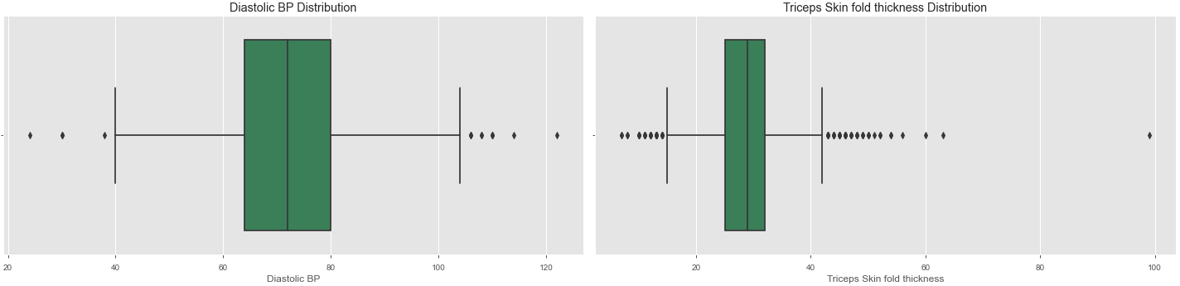
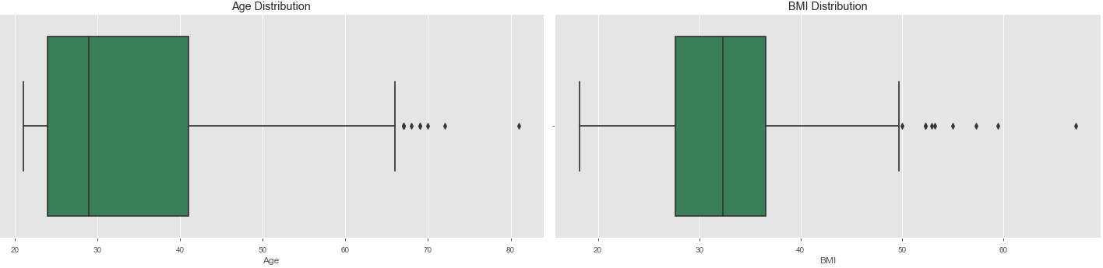
Outliers Analysis
From the box plots, we can observe the following:
Most of the variables have a presence of outliers.
Understand the nature of the outlier: Before taking any action, it's essential to investigate the outlier and understand why it deviates significantly from the rest of the data. Is it due to measurement errors, data entry mistakes, or is it a legitimate extreme value? Understanding the cause will help determine the appropriate handling method.
Since we don’t have the above information, we will use algorithms which are ROBUST to outliers.

Slide 10
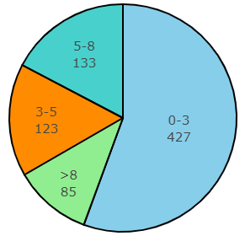
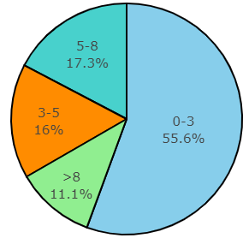
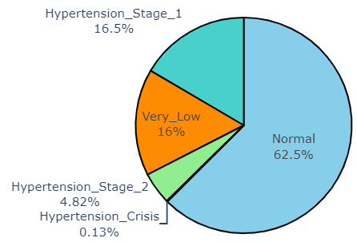
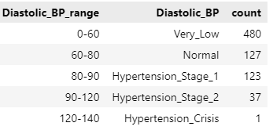
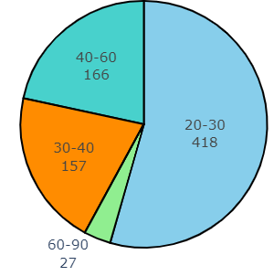
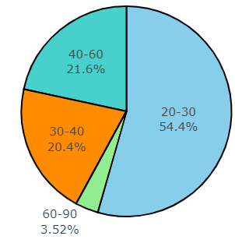
Feature Engineering
Pregnancy Stages
Diastolic BP Stages
Age Groups
I performed Discretization/Binning on some features as a feature engineering technique.
Discretization/Binning – It is the process of turning a continuous feature into a discrete feature. This is done by creating buckets for the given values. This technique is supposed to be more helpful with limited training data.
I created bins for 3 features - Number of times Pregnant, Age and Diastolic BP
Age: The Dataset has most number of women belong to 20-30 age group, followed by 40-60, 30-40 and 60-90.
Diastolic BP: ~62% of women have within the normal range, 16% of women having very low range and ~21% are in Hypertension stage.
Number of times Pregnant: ~29% of women got pregnant more than 5 times.

Slide 11
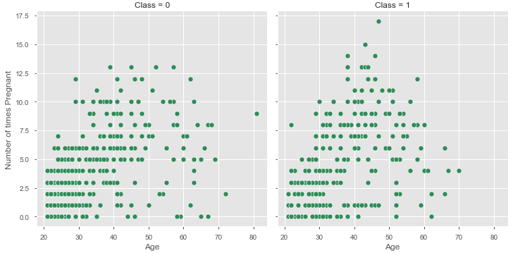
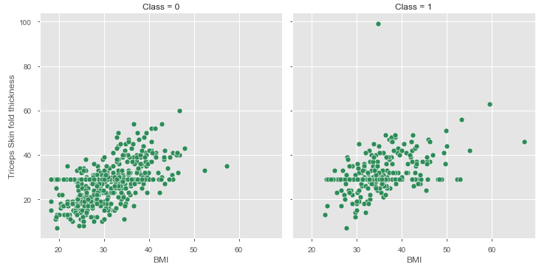
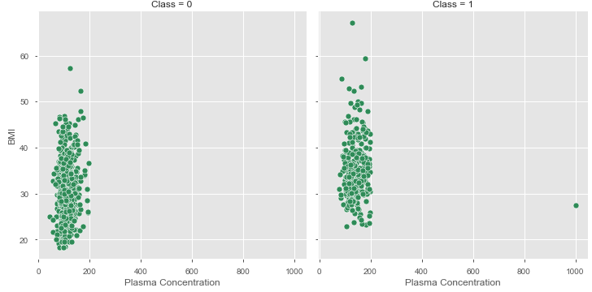
Bi-variate Analysis
Age & Number of times Pregnant
BMI and Triceps skinfold thickness
Plasma Concentration and BMI
In reference with Correlation Heatmap, we had the most correlation among below -
Age vs Number of pregnancies - There is a relationship between age and the number of pregnancies a women had, specifically in the context of gestational diabetes mellitus (GDM). Gestational diabetes is a type of diabetes that occurs during pregnancy and typically resolves after delivery. It is characterized by high blood sugar levels that develop or are first recognized during pregnancy.
BMI vs Triceps skinfold thickness - The relationship between body mass index (BMI) and Triceps skinfold thickness can provide insights into how body weight is distributed, particularly the amount of subcutaneous fat. Individuals with higher BMI values and increased triceps skinfold thickness may have a greater proportion of body fat, thereby an increased risk of diabetes.
Plasma Concentration vs BMI - Diabetes has a significant impact on plasma concentration levels of various substances, particularly glucose and insulin, it causes a dysregulation of blood glucose levels.

Slide 12
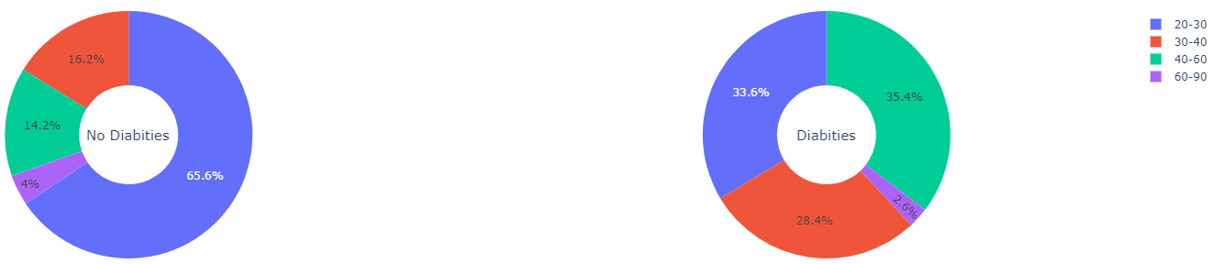
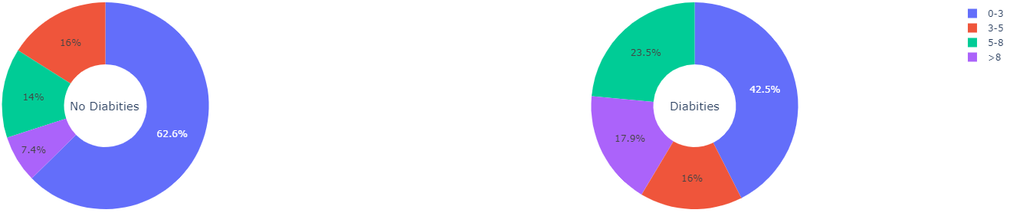
Bi-variate Analysis
Diabetes Rate across Age Groups
Diabetes Rate across # of Pregnancies
~35% of Diabetic women belong to 40-60 years of age-group.
~34% of Diabetic cases belong to women in their twenties, implying poor sedentary lifestyle among youngsters.
Older women having 60-90 years of age-group have less chances of being diabetic.
~43% of Diabetic women has number of pregnancy between 0-3.
Higher number of pregnancy is one of the major cause of diabetes. ~41% of diabetic women got pregnant >5 times.

Slide 13
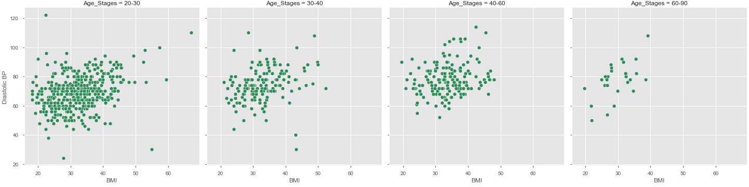
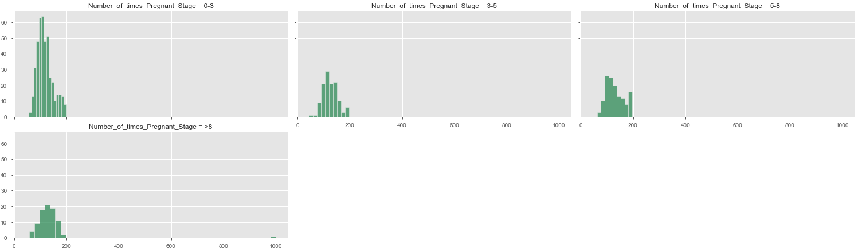
Bi-variate Analysis
BMI & Diastolic BP across Age Stages
Diastolic BP concentration is in between 30-40 range across every age group.
Plasma Concentration is around 120 across every pregnancy stage.
Plasma Concentration across # of Pregnancies
In reference with Correlation Heatmap -
There is can be a relationship between

Slide 14
Model Development - Comparison Analysis

Slide 15
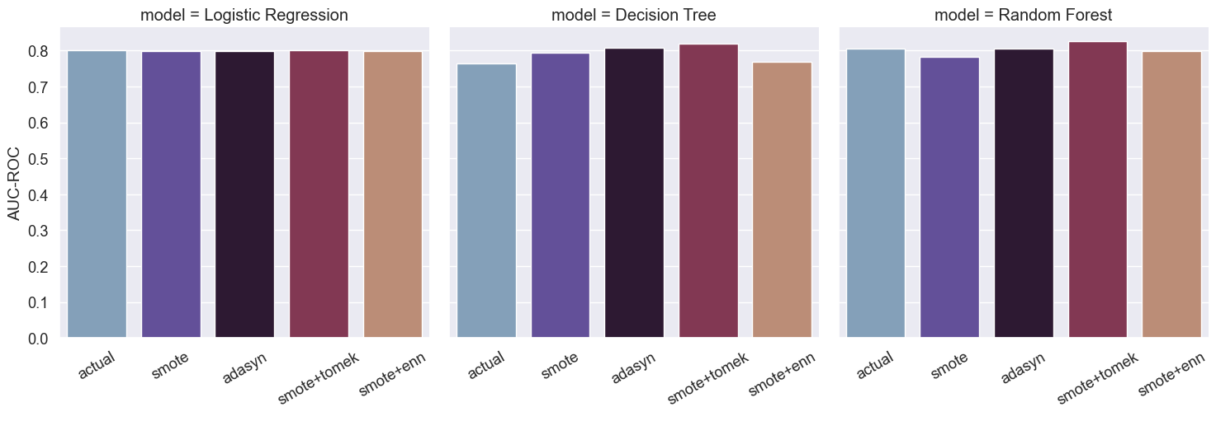
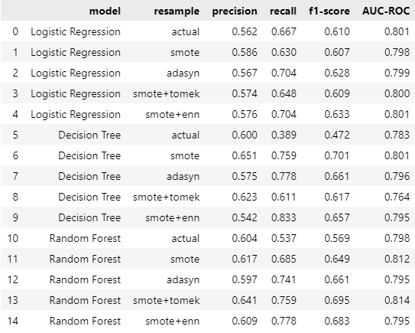
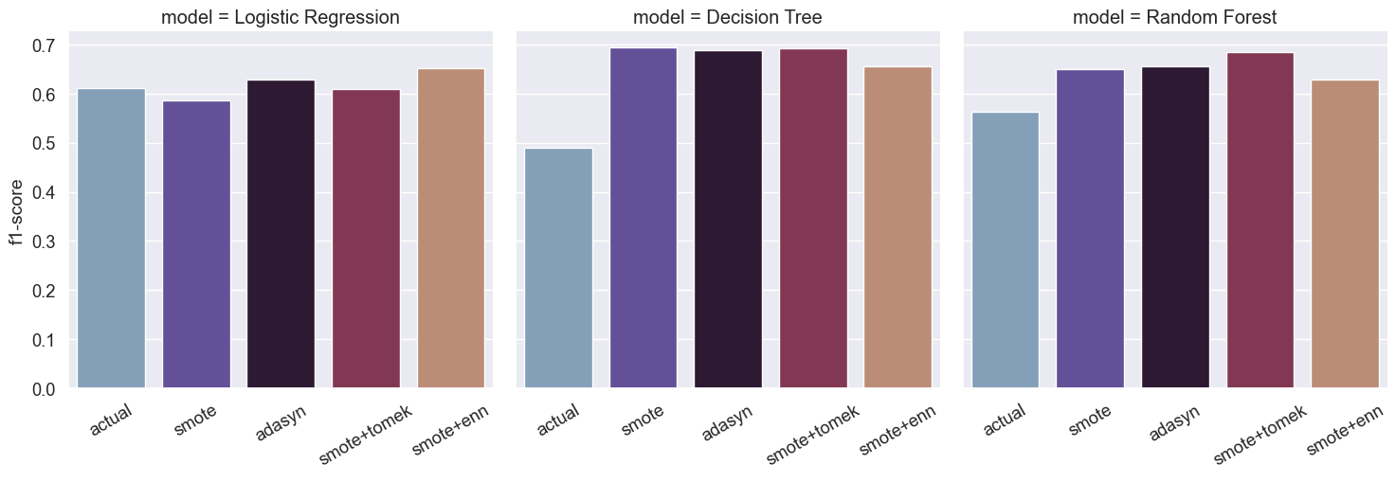

Model Comparison across Imbalanced Techniques
Metric = AUC-ROC
Model Results Comparison
Metric = F1-Score
Summary
I tried 3 models - Logistic Regression, Decision Tree and Random Forest and applied multiple sampling techniques like SMOTE, ADASYN, SMOTE-Tomek and SMOTEENN.
I evaluated these models using F1-Score and AUC-ROC which are robust metrics for evaluating imbalanced data.
All 3 models gave similar results with minor differences.
Due to the presence of outliers in our data, we should go ahead with Random Forest with SMOTE-Tomek sampling method.
Random forest produces results with Low Bias and Low variance making it the most suitable choice among the rest.

Slide 16
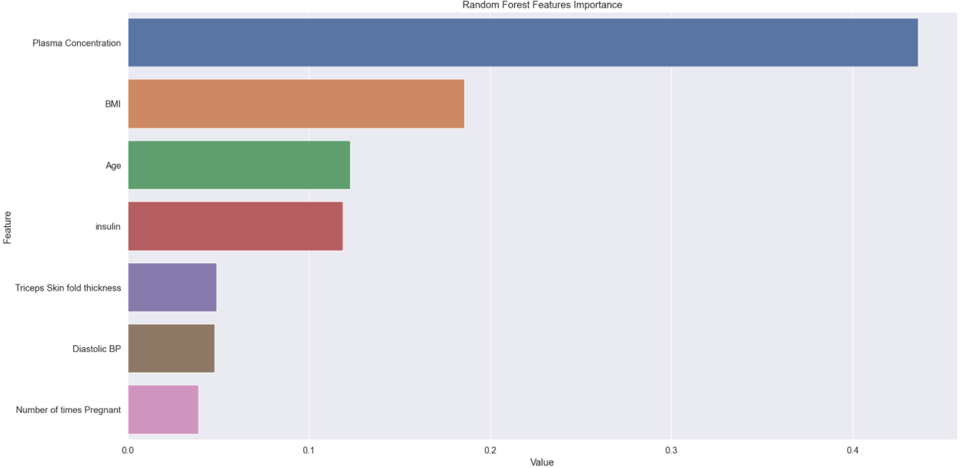
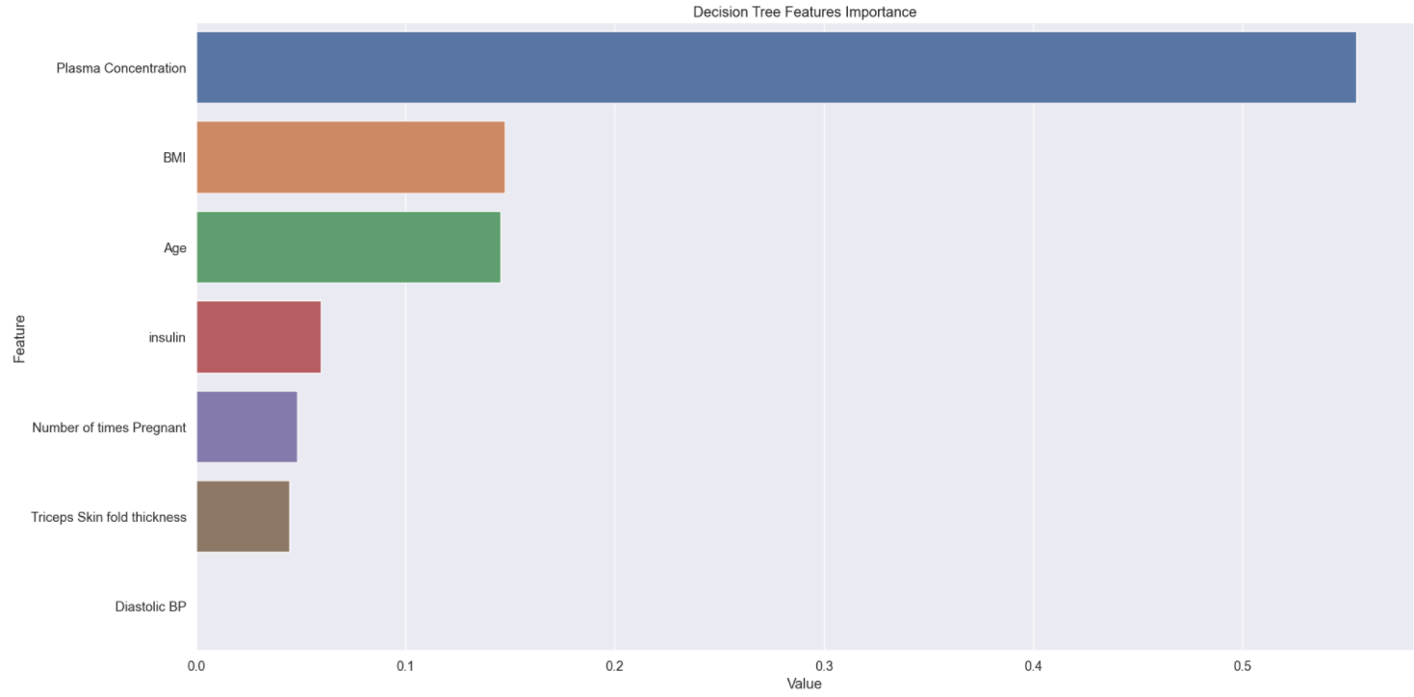
Feature Importance Graph
Random Forest Features Importance
In reference to Features Importance graph, Top 4 features to determine Diabetic or Non- Diabetic are –
Plasma Concentration
BMI
Age
Insulin
Plasma Concentration importance in model result is the most significant, and its value is far greater than all other feature values, making it the most critical feature
Metric = F1-Score
Decision Tree Features Importance
Diastolic BP importance is negligible in Decision Tree model result which may not be accurate, hence with limited features it’s better to consider ALL features to determine the Class (Diabetic or Non- Diabetic).

Slide 17
Conclusion

Slide 18
Conclusion
Due to the presence of outliers in our data, we should go ahead with Random Forest with SMOTE-Tomek method which produces the best results (AUC-ROC 0.814, F1-Score 0.695).
Random forest produces results with Low Bias and Low variance making it the most suitable choice among the rest.
Top 4 features to determine Diabetic or Non- Diabetic are –
Plasma Concentration
BMI
Age
Insulin
Plasma Concentration importance in model result is the most significant, and its value is far greater than all other feature values, making it the most critical feature.

Slide 19
Thank You

